Slide 1
Team 10
Contact-free RFID Ticketing System
Team members: Drew Mohundro, Alex Bigej, Preston May, Carol Pollard, Garrett Smith

Slide 2
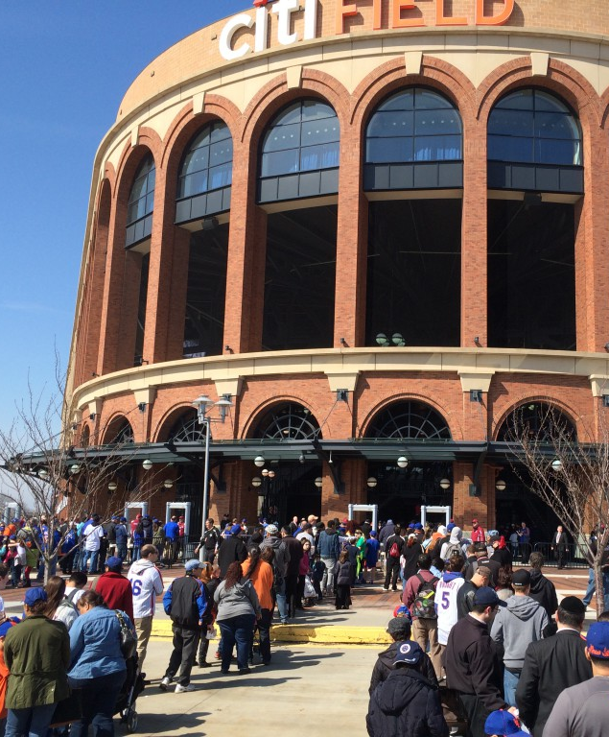
Problem / Opportunity
Long wait times at large venues
More event staff required for ticketing
Hard to keep up with paper tickets
Security measures further slowing entry
Similar devices are expensive and limited on volume
Figure 1: Long Lines
Source: [1]

Slide 3

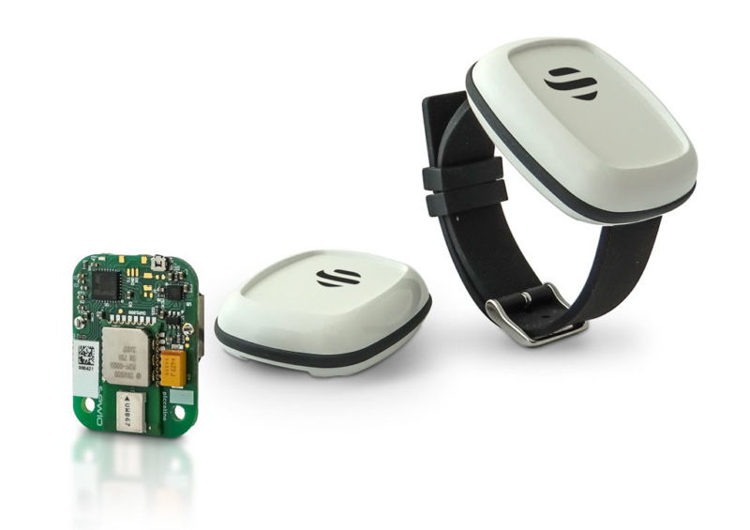
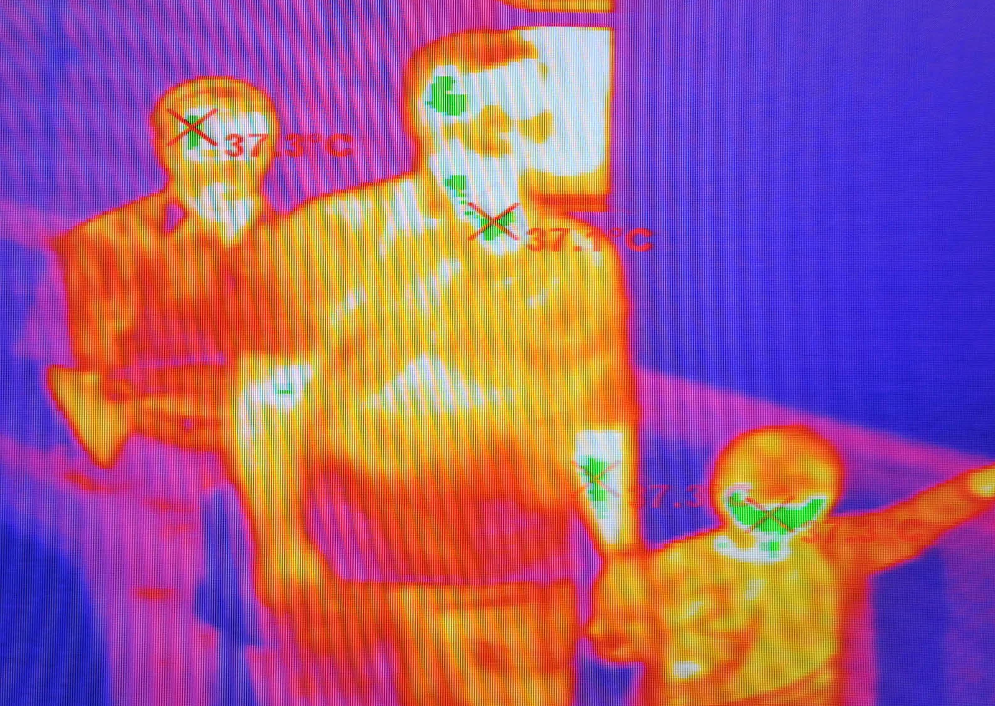
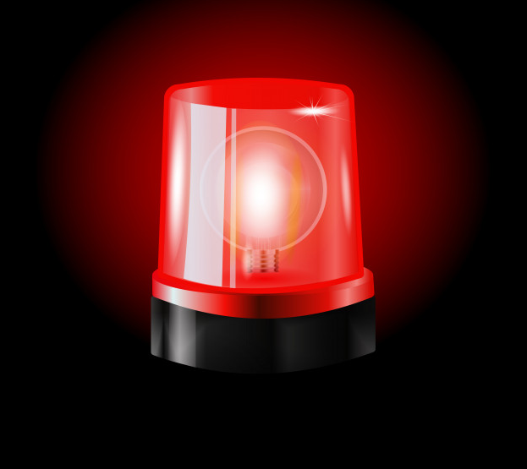
Solution
Reusable ticket with a distinct signal
Sensors pass signal ID to controller
Controller checks account for valid tickets
Thermal imaging determines persons to tickets ratio
LED notification system for any errors

Slide 4
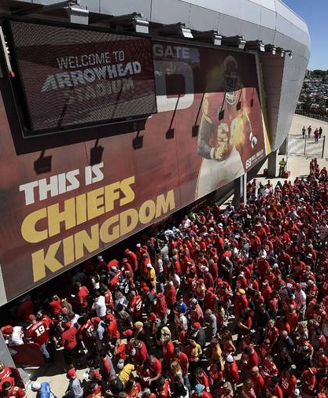
Target Customer
Athletic Directors
Owners of large venues
Any venue that can benefit from lower queue times

Slide 5
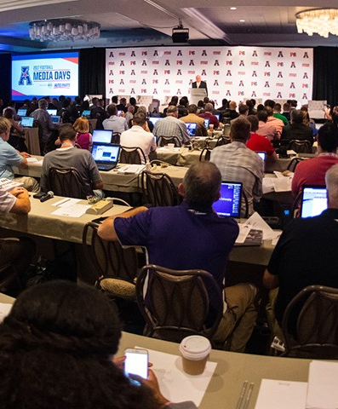
Sales
Attract customers by demonstrating high reliability and throughput
Work directly with the Athletics department to sell/distribute the detectors

Slide 6
Competitive Advantage
There exist viable competitors for single-user, unmanned solutions (i.e. turnstiles)
There also exist viable competitors for multi-user, manned solutions (i.e. handheld scanners, manual counting of users)
Our product is an unmanned ticketing solution that can handle multiple users at a time.

Slide 7
References
[1] deMause, Neil. "Metal Detectors at MLB games proving to be just as bad an idea as everyone feared." Field of Schemes, http://www.fieldofschemes.com/2015/04/07/8776/metal-detectors-at-mlb-games-proving-to-be-just-as-bad-an-idea-as-everyone-feared/ (accessed Aug. 21, 2020)
[2] "Future of stadiums, arenas promise high tech, low capacity." Associated Press, https://www.staradvertiser.com/2020/05/31/sports/sports-breaking/future-of-stadiums-arenas-promise-high-tech-low-capacity/ (accessed Aug. 21, 2020)
[3] "Media Services." The American, http://theamerican.org/sports/2013/8/8/ABOUT_0808134329.aspx?path=about (accessed Aug. 21, 2020)
[4] Freepik Company, https://www.freepik.com/premium-vector/red-flashers-siren-vector-realistic-object-light-effect-beacon-police-cars-ambulance-fire-trucks-emergency-flashing-siren_6462750.htm (accessed Aug. 22, 2020)
[5] Freepik Company, https://www.freepik.com/premium-vector/wifi-sign-with-digital-communication-interface_5034460.htm#page=2&query=wifi&position=29 (accessed Aug. 22, 2020)
[6] "UWB Tags." Sewio Networks, https://www.sewio.net/legacy-uwb-tags/ (accessed Aug. 21, 2020)
[7] Simonite, Tom. "Infrared Cameras Can Spot a Fever, but May Not Slow Covid-19." WIRED, https://www.wired.com/story/infrared-cameras-spot-fever-not-slow-covid-19/ (accessed Aug 21, 2020)
ras-spot-fever-not-slow-covid-19/
https://www.sewio.net/legacy-uwb-tags/

